Slide 1

Optical Flow-Based Motion Detection and Object Tracking in Video
21CSE454T – Computer Vision
SRM Institute of Science and Technology
A comprehensive exploration of motion estimation techniques, optical flow visualization, and real-time object tracking in video sequences through computational methods and visual analysis.

Slide 2
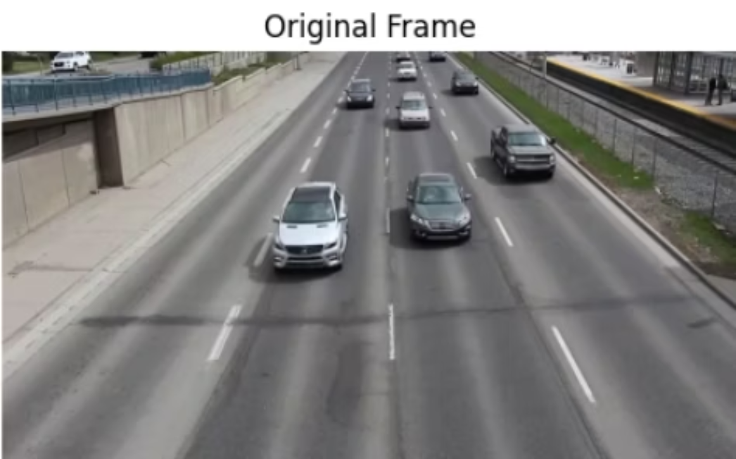
Aim & Objectives
Aim
Original video frame showing motion in scene
Analyze and visualize motion between consecutive video frames using optical flow estimation techniques to understand directional movement and velocity patterns.
Key Objectives
Dense Optical Flow
Estimate motion direction and speed at each pixel using the Farneback method.
HSV Color Mapping
Visualize flow vectors through color-coded representations of direction and magnitude.
Motion Detection
Detect and isolate moving regions through thresholding and region analysis.
Comparative Analysis
Compare optical flow with background subtraction for robust motion tracking.

Slide 3

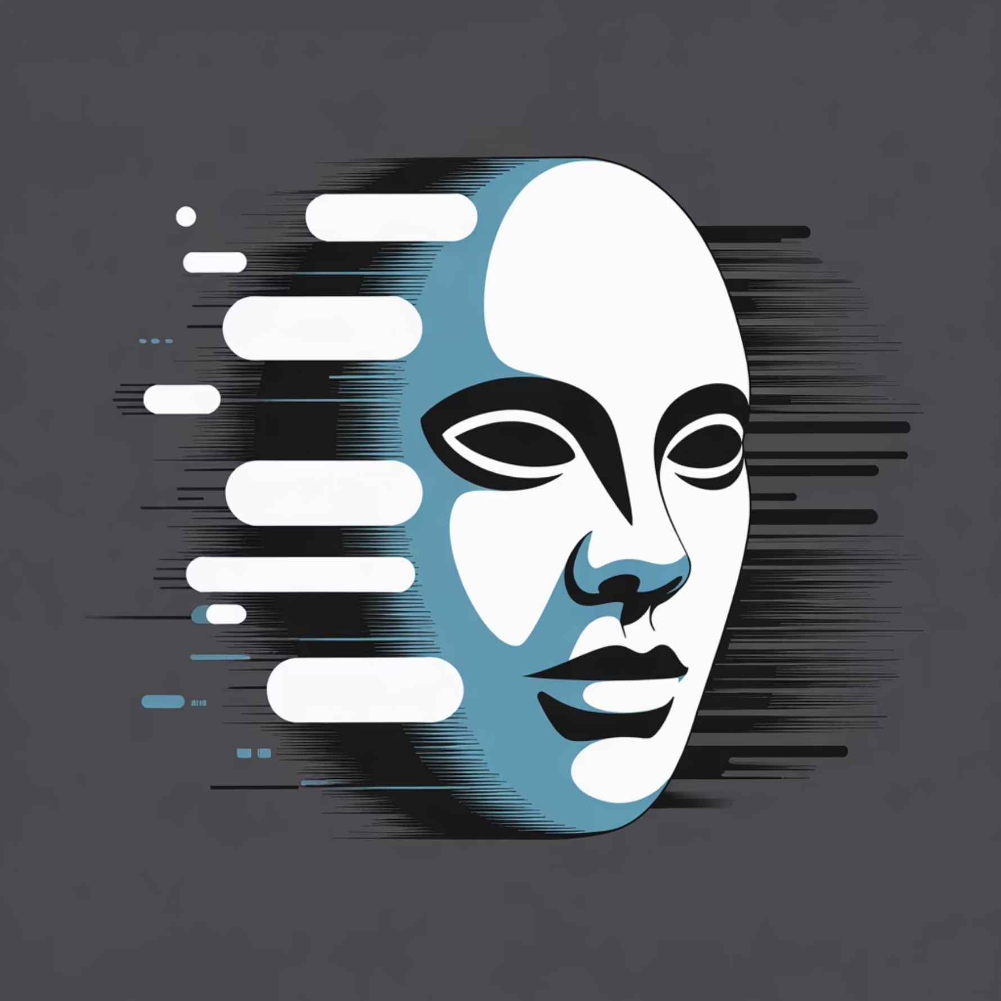
Algorithmic Methodology
The optical flow computation pipeline converts raw video sequences into interpretable motion representations through a structured five-step process.
01
02
03
Grayscale Conversion
Optical Flow Computation
HSV Color Mapping
Convert consecutive RGB video frames to single-channel grayscale for intensity-based motion analysis.
Apply Farneback algorithm to compute dense optical flow, estimating motion vectors for each pixel location.
Encode flow direction as hue and magnitude as saturation, converting to RGB for visualization.
04
05
Motion Magnitude Thresholding
Background Subtraction
Extract moving regions by thresholding flow magnitude to create binary motion masks.
Apply MOG2 background subtractor to isolate foreground motion and enhance tracking robustness.
Optical Flow Visualization (HSV Color Map)
Motion Magnitude Mask (Thresholded)

Slide 4
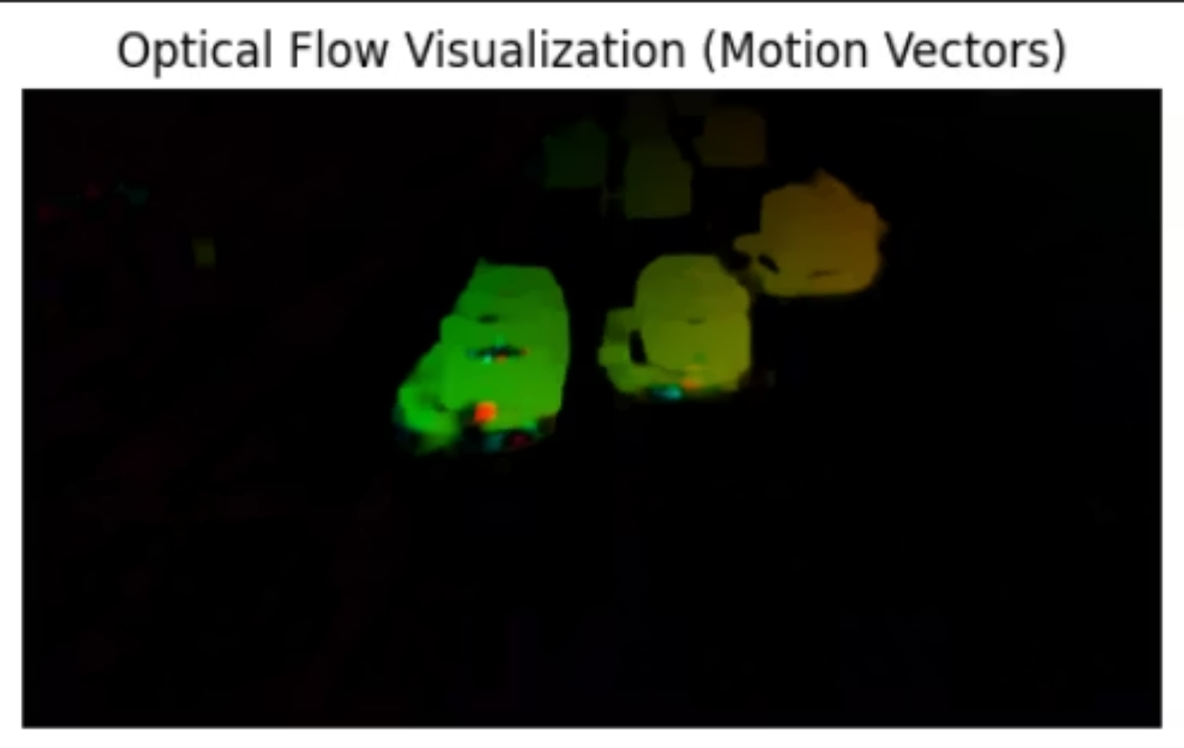
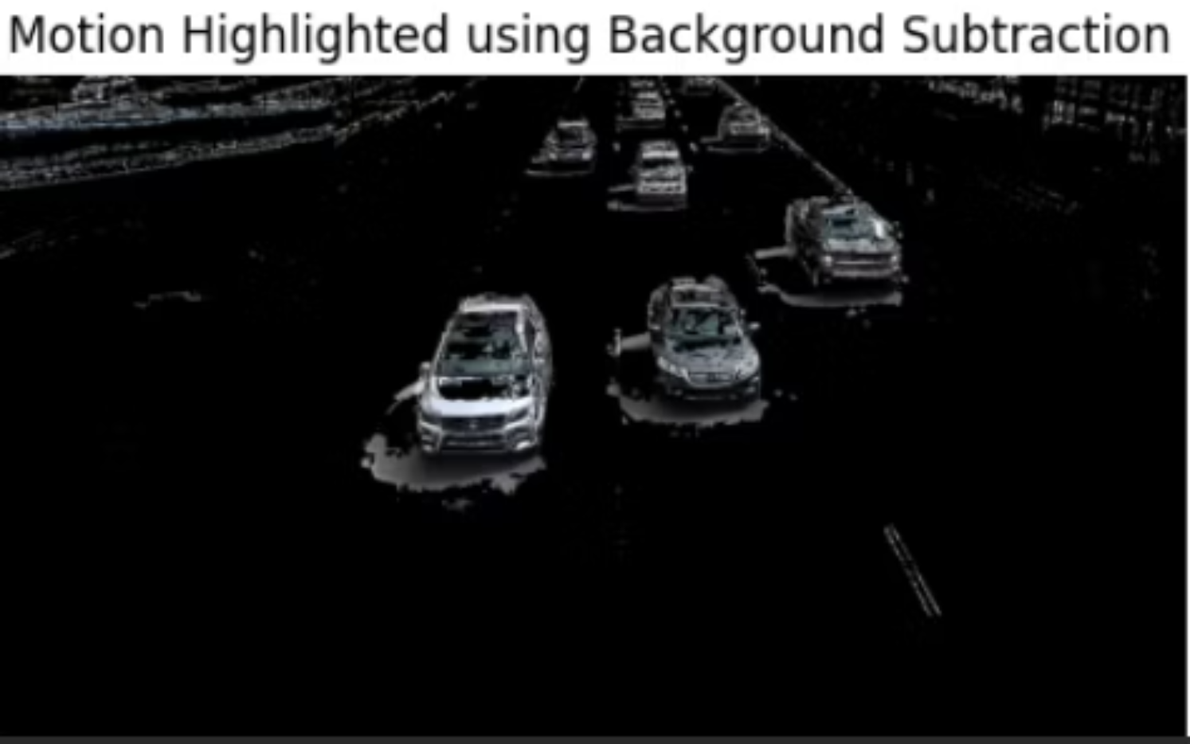
Implementation & Technical Stack
Development Environment
Farneback Method
Language: Python 3.8+
Polynomial expansion for robust dense optical flow estimation across video frames.
Platform: Google Colab with GPU acceleration
Core Libraries: OpenCV, NumPy, Matplotlib
Input & Processing Pipeline
MOG2 Background Subtractor
Input: Video sequences featuring pedestrians, vehicles, or synthetic motion.
Adaptive Gaussian mixture model for real-time foreground segmentation and motion isolation.
Processing: Frame extraction → grayscale conversion → optical flow computation → HSV visualization → motion region detection → background subtraction filtering.
HSV Color Space
Hue encodes motion direction; saturation/value encode magnitude for intuitive visualization.
Optical Flow Output (Early Frames)
Motion Highlighted (Background Subtraction)

Slide 5

Comparative Results & Analysis
Multi-method motion analysis demonstrates complementary strengths of optical flow and background subtraction approaches.
Original Frame
Optical Flow (HSV)
Motion Mask
Background Subtraction
Unprocessed video frame showing baseline scene content and motion subjects.
Color-encoded motion vectors revealing pixel-level direction and speed information.
Binary representation of thresholded flow magnitude isolating dynamic regions.
Foreground segmentation using MOG2 model for robust moving object isolation.
Key Observations
Optical flow provides continuous pixel-wise motion estimation with directional information.
Color intensity directly represents movement magnitude for intuitive interpretation.
Background subtraction delivers clean foreground silhouettes for object-level tracking.
Combined methods enhance tracking robustness through complementary motion signatures.

Slide 6
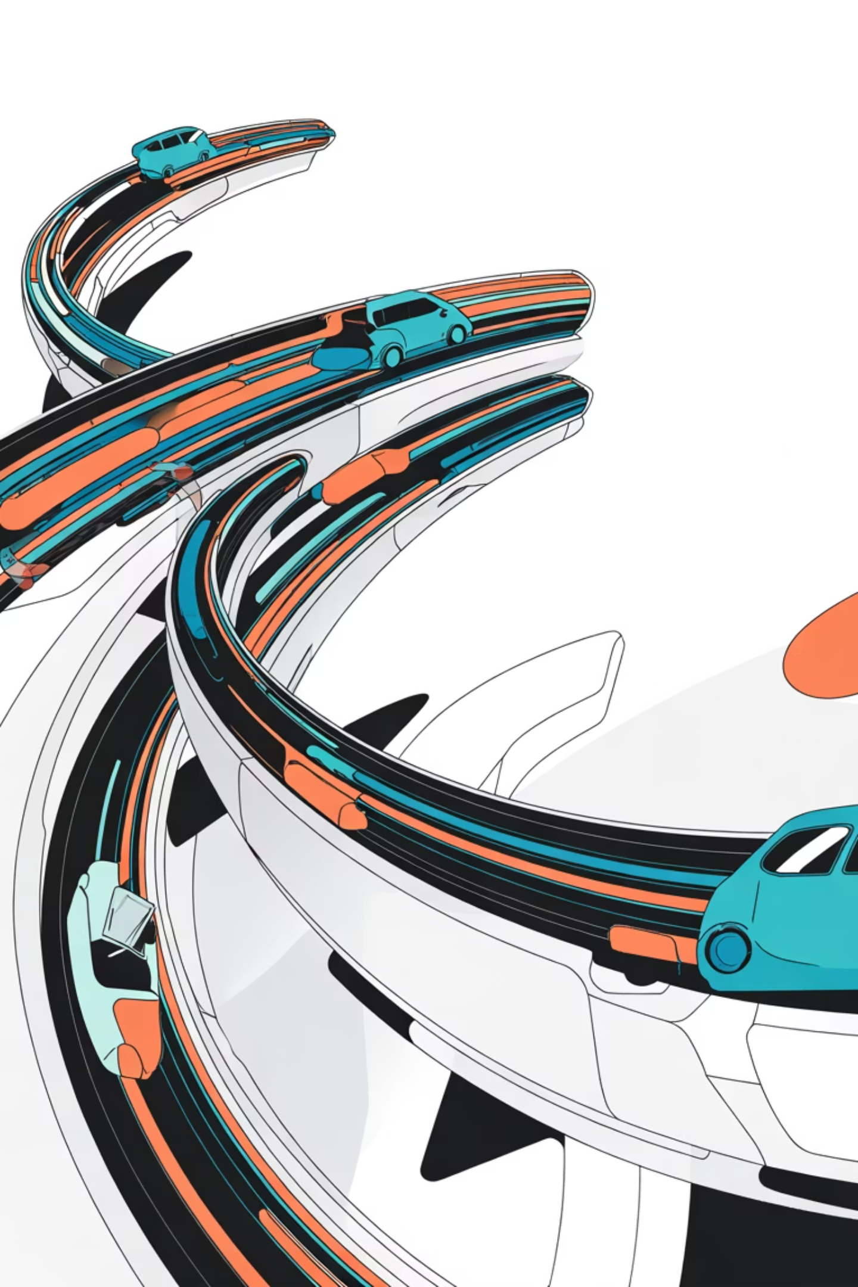
Conclusions & Future Directions
Conclusions
Future Scope
Optical flow effectively detects and visualizes object motion in video sequences through dense motion estimation. Integration with background subtraction creates robust motion detection pipelines suitable for surveillance, autonomous systems, and robotics applications.
Multi-Object Tracking
Extend algorithms using Kalman filters and Mean-Shift methods for simultaneous tracking of multiple moving entities.
Key Achievements
Deep Learning Integration
Successful dense optical flow implementation and visualization
Incorporate FlowNet2.0 and similar CNN architectures for improved real-time performance and accuracy.
Effective motion region detection via magnitude thresholding
Validated background subtraction performance
Demonstrated complementary method strengths
Robustness Enhancement
Develop advanced noise handling and illumination-invariant techniques for challenging conditions.
Enhanced motion tracking combining optical flow and foreground segmentation

